Slide 1
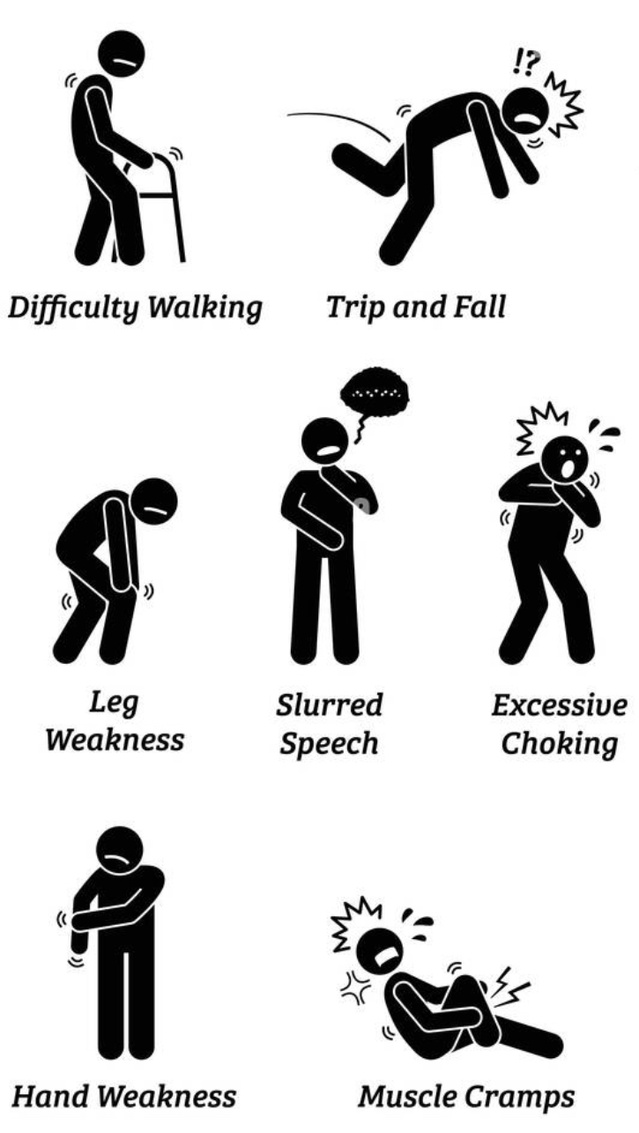

What does it look like? presentation
Early Stage - first region involvement
Muscle weakness, twitches, and cramping, followed by problems with balance, coordination, and gait.
Increasing effort to breathe, slurred speech, and some difficulty chewing and swallowing.
No typical impact to behavior or cognition
This is where voice banking may begin and touch or switch AAC prescribed
Middle Stage - two to three regions involved
Most muscles paralyzed, atrophied, or permanently constrained.
By this time a wheelchair and respirator are typically prescribed and constant care is needed for daily activities.
A small portion of ALS patients may spontaneously laugh or cry (pseuobulbar affect), and nearly 50% show some signs of Aphasia-like language impairments
Users will require eye gaze or complex switch access through the entirety of this phase
The end of this stage is typically marked by gastronomic intervention (a feeding tube)
Late Stage - end of life
The top causes of death are respiratory failure, pneumonia, and heart complications (in order)
Around 30% of patients by this stage will exhibit dementia and/or severe aphasia
The transition from eye gaze to necessary use of BCI is at first involvement of the Trochlear nerve (coming up)
Typically 2-5 years after initial onset, but those diagnosed younger than 50 generally exceed that
©2022 Proprietary and Confidential. All Rights Reserved.

